Slide 1
Lab. 02
Logic Design Lab.
Spring 2018
Prof. ChangGun Lee
(cglee@snu.ac.kr)
TA. Wonjae Jang
TA. Wonseok Lee
TA. Dongwan Kang
TA. Alena Kazakova
(ta@rubis.snu.ac.kr)

Slide 2
Team
강단
1조 김무환 심유근 김광현 | 6조 이용규 이재영 | 11조 박윤빈 이성찬 박지선 | 16조 이동학 전유리 | 21조 김진영 장태준 한종우 | 26조 강지호 김영인
2조 최지혁 이정훈 | 7조 이강욱 박혜정 | 12조 김영현 현지훈 | 17조 정찬영 홍석준 | 22조 김동우 이효준 | 27조 서준원 김해수
3조 신동민 조유진 | 8조 정유석 나혜주 | 13조 이정민 이태민 | 18조 김도현 음정훈 | 23조 이드로 민경효 | 28조 안세진 한상현
4조 송재윤 신재호 | 9조 백도원 박지나 | 14조 김현빈 최창민 | 19조 허진수 정재훈 | 24조 박지용 백근영 | 29조 김준오 김대은
5조 김수인 백우현 | 10조 강호찬 성명석 | 15조 강휘현 한상준 | 20조 백동진 홍선기 | 25조 신수웅 문정원 | 30조 김태범 레이첼 간
문

Slide 3
About the Locker
Team 2n-1 & 2n use one locker together (number: n)
How to set password
Close door and press 4-digits (after reset password)
How to reset password
Call T.A. so be careful.
Sometimes it doesn’t work properly because of battery problem.
Call T.A.

Slide 4
Notification
For the report
There is no sample form. Put today’s results and homework altogether and make it as one file. Follow the title format as described in ‘Course Information’.

Slide 5
Contents
Combinational logic practice
Tactile switches
LEDs
Pull-up & pull-down resistors
Practice: Half-adder implementation
Function generator and oscilloscope
Soldering
Homework

Slide 6
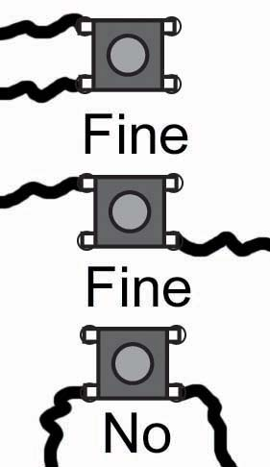
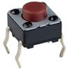
Combinational Logic Practice
Tactile switches
①
④
④
①
③
②
②
③
Tactile Switch
Circuit Diagram
Usage

Slide 7
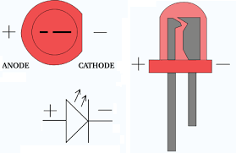
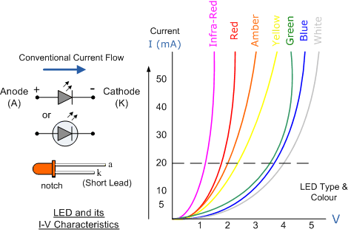
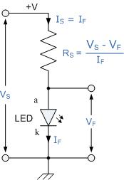
Combinational Logic Practice
LEDs
LEDs emit colored light when passed through by forward current
To protect LED from excessive current flow, using an appropriate resistor(around 3~400Ω) is necessary

Slide 8
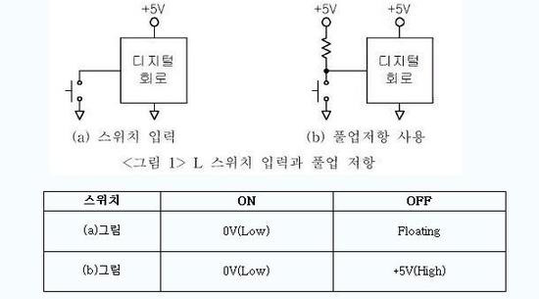
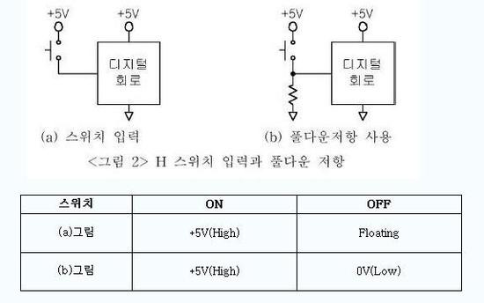
Combinational Logic Practice
Pull-up & pull-down resistors
Digital Circuit
Digital Circuit
Digital Circuit
Digital Circuit
(a) Switch Only
(b) Pull-up resistor
(a) Switch Only
(b) Pull-down resistor
<Pic 1> L switch & Pull-up resistor
<Pic 2> H switch & Pull-down resistor
switch
switch
Pull-up Resistor
Pull-down Resistor

Slide 9
Combinational Logic Practice
Pull-up & pull-down resistors
Digital Circuit
Digital Circuit
Digital Circuit
Digital Circuit
(a) Switch Only
(b) Pull-up resistor
(a) Switch Only
(b) Pull-down resistor
<Pic 1> L switch & Pull-up resistor
<Pic 2> H switch & Pull-down resistor
switch
switch
Pull-up Resistor
Pull-down Resistor
Switch on
Switch off

Slide 10
Combinational Logic Practice
Pull-up & pull-down resistors
Digital Circuit
Digital Circuit
Digital Circuit
Digital Circuit
(a) Switch Only
(b) Pull-up resistor
(a) Switch Only
(b) Pull-down resistor
<Pic 1> L switch & Pull-up resistor
<Pic 2> H switch & Pull-down resistor
switch
switch
Pull-up Resistor
Pull-down Resistor
Switch on
Switch off

Slide 11
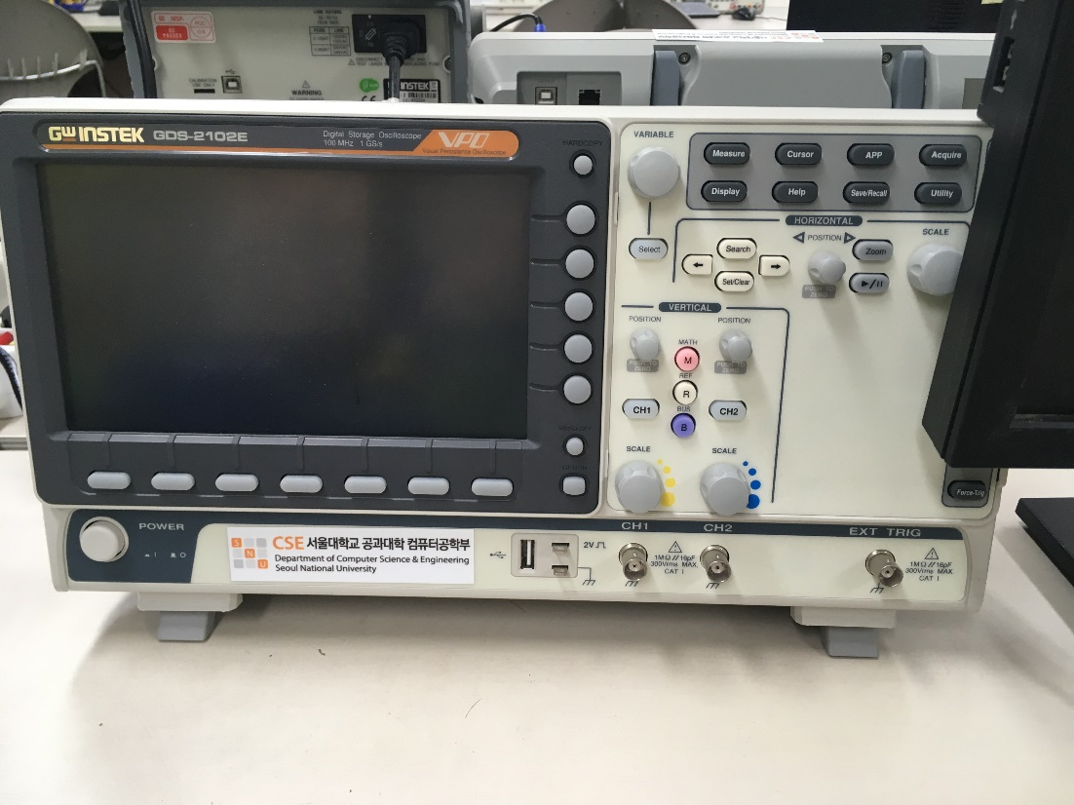
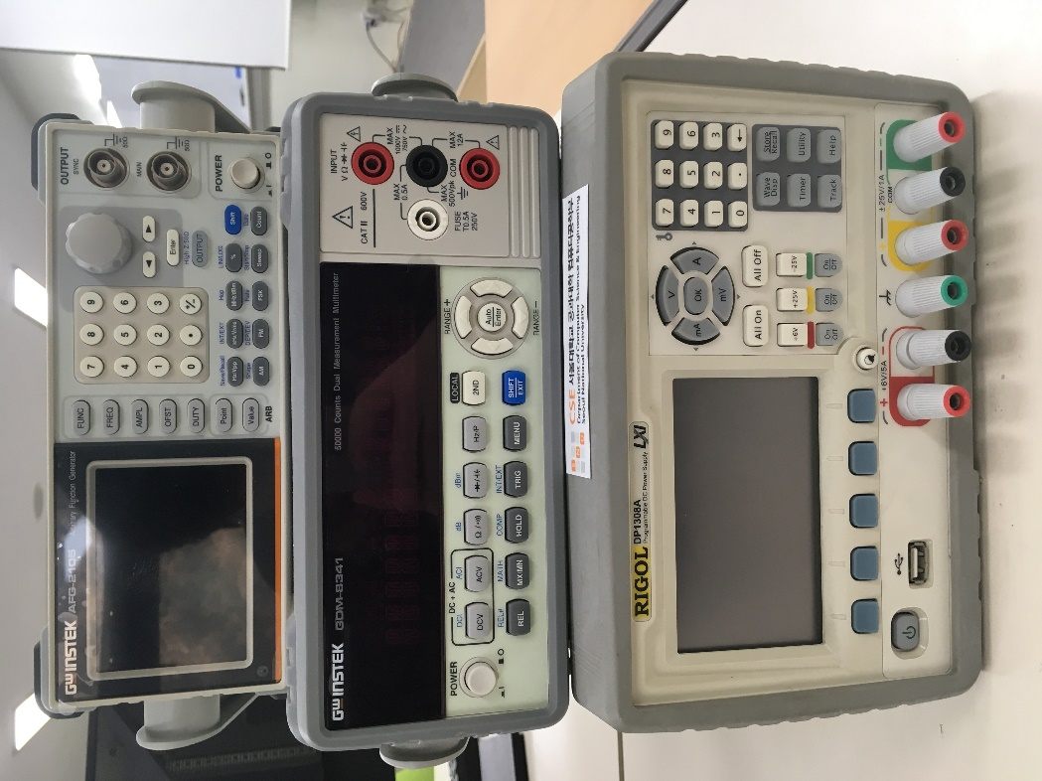
Instruments
oscilloscope
Function Generator
Multimeter
Power Supply

Slide 12
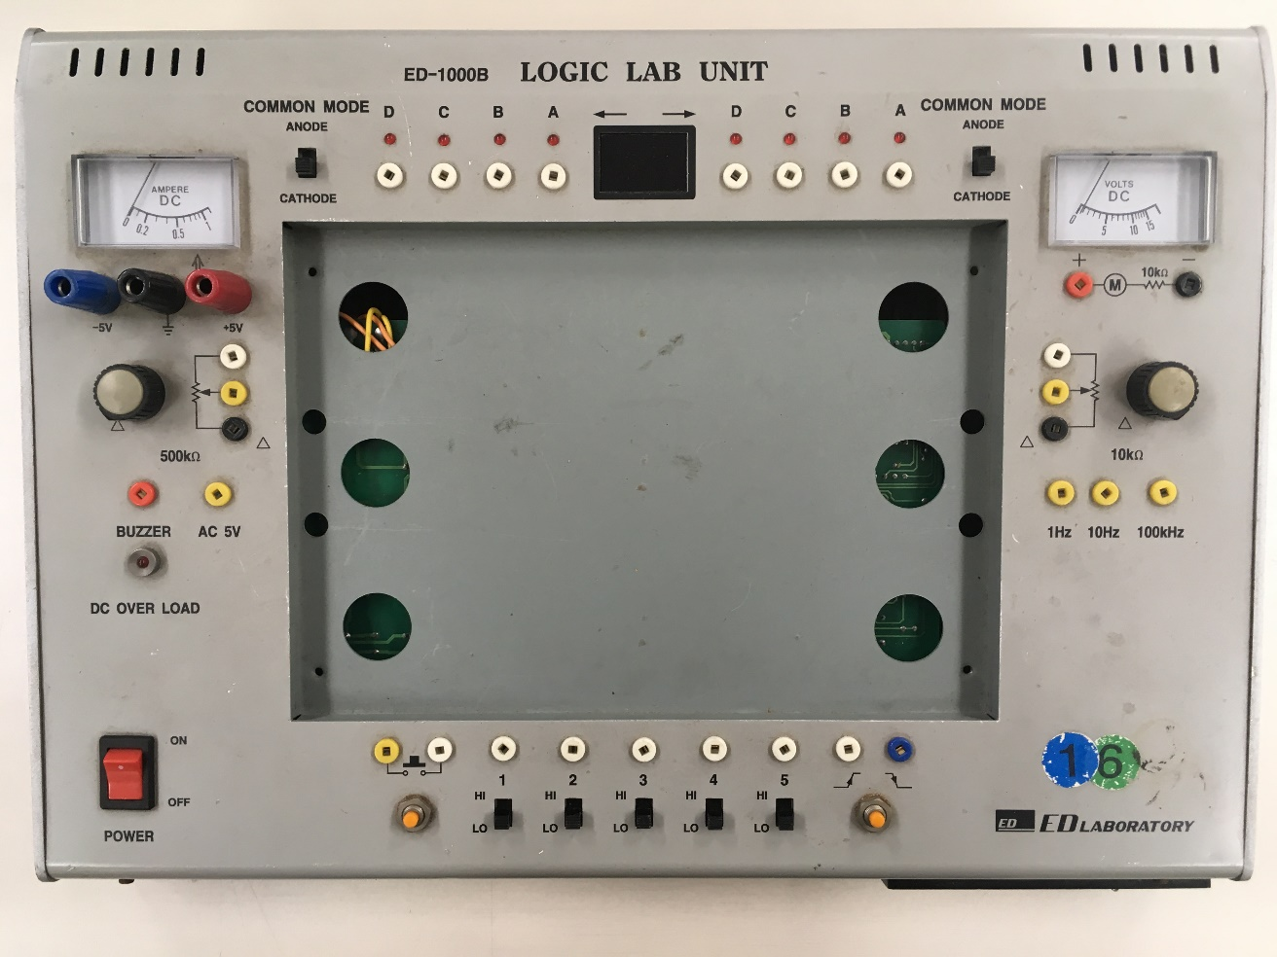
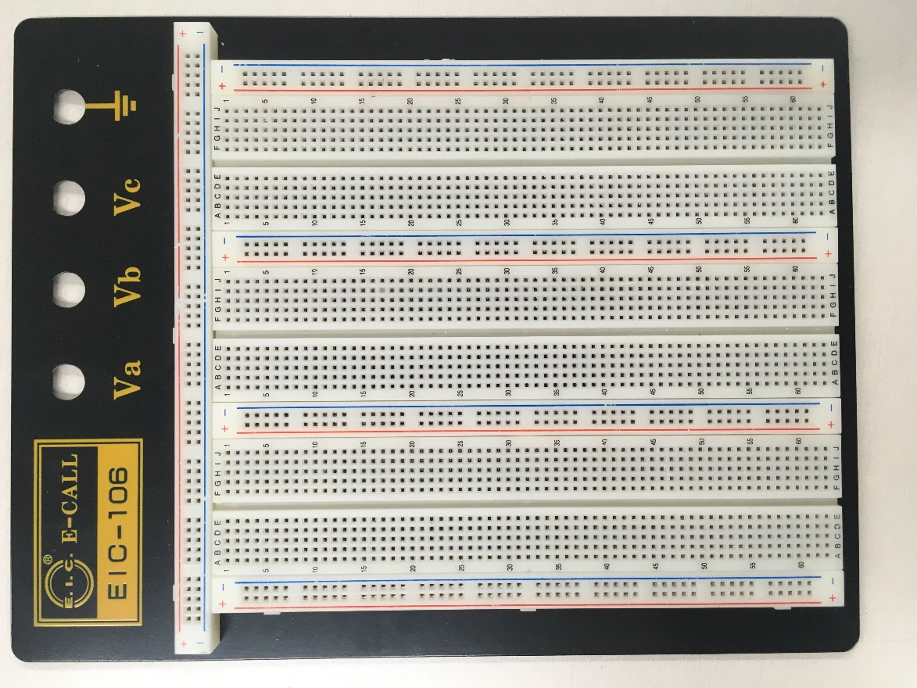
LAB Unit & Bread Board

Slide 13
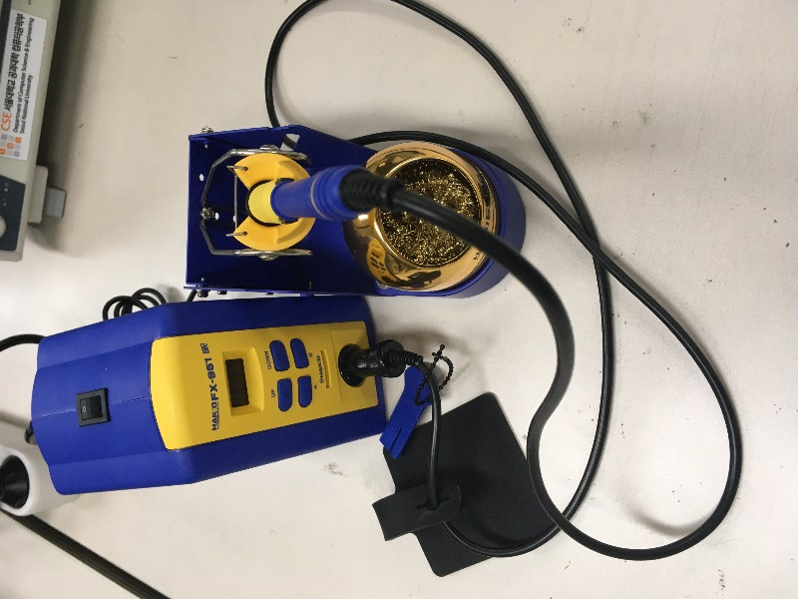
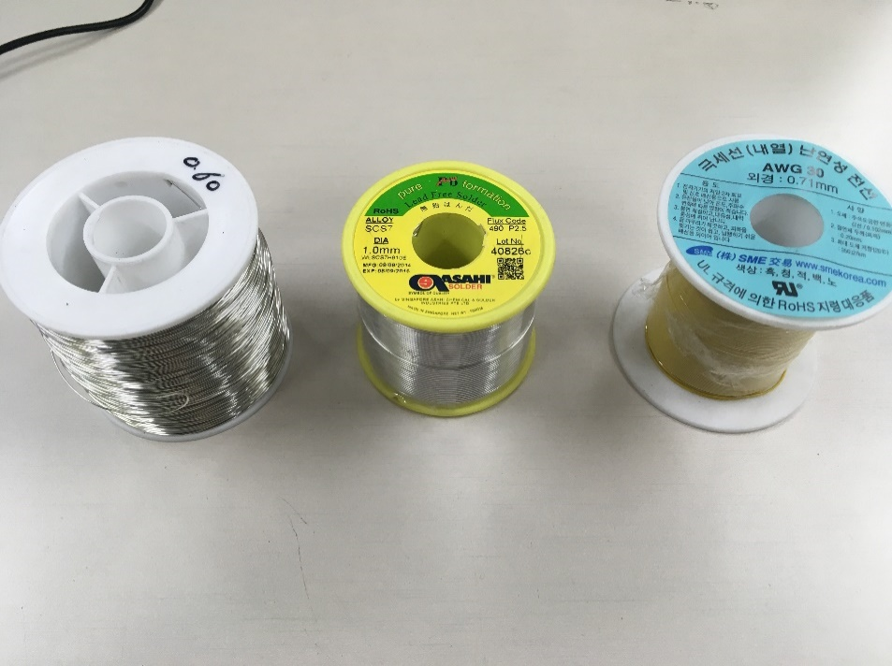
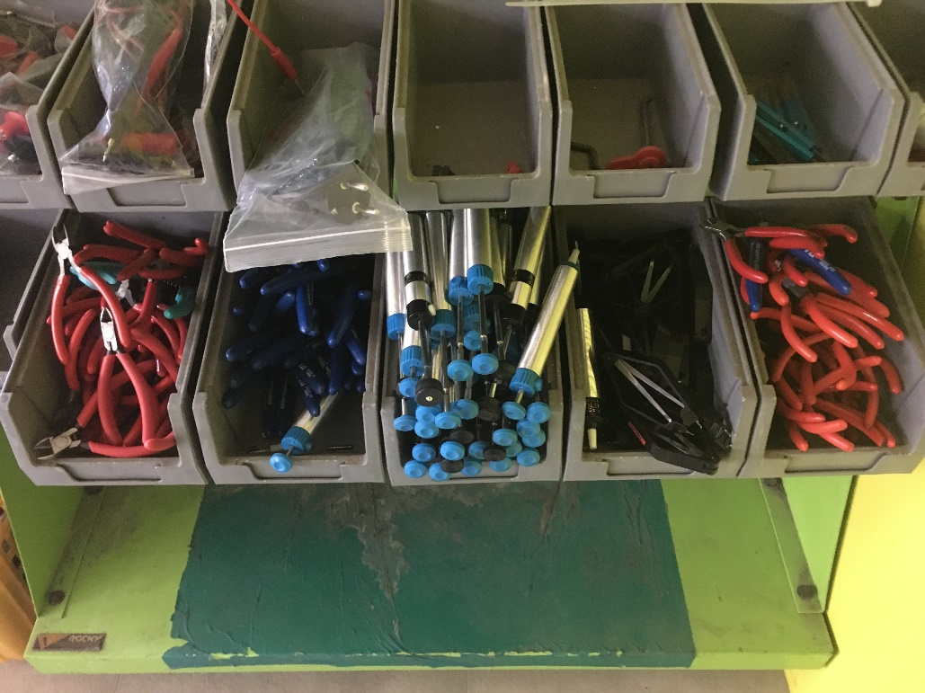
Soldering
Tools – Solder, Soldering iron, Tip, etc
Soldering iron
Tin wire Solder Wire
Nipper Bead nipper Desolder Chip extractor Long-nose plier

Slide 14
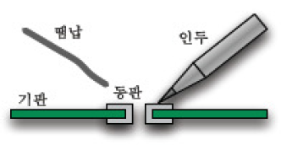
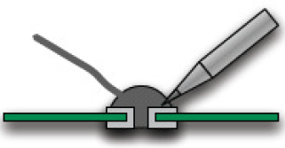
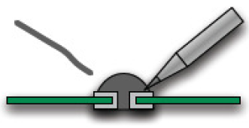
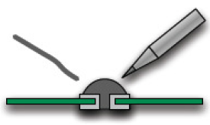
Soldering
Procedure
Solder
Soldering
iron
Subsrate
- Put the tip of the soldering iron
on a target and heat that spot.
- Put the solder on the tip of the soldering
iron and melt down the solder.
- Take the solder off.
- Take the tip off.

Slide 15

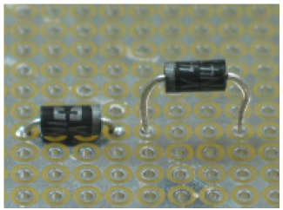

Soldering (Cont’d.)
Wrong cases
Amount of solder is wrong!
Components must be pressing against the board.
Taking a tip off is too late!
Temperature of the soldering iron is not high enough!

Slide 16
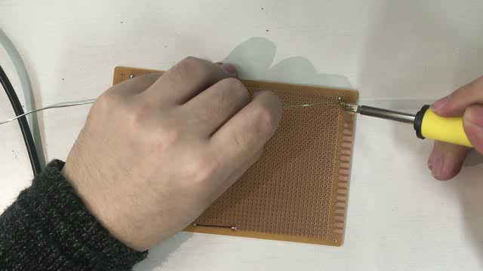
Soldering (Cont’d.)

Slide 17
Lab

Slide 18
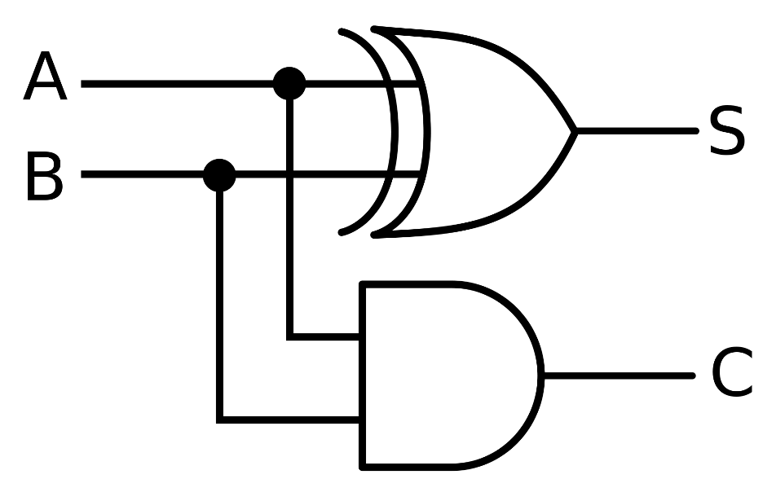
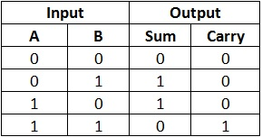
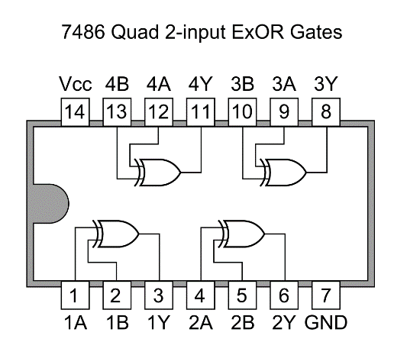
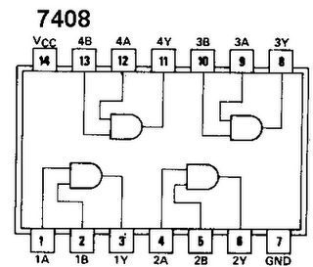
Combinational Logic Practice
Practice: Half-adder implementation
Let’s implement half-adder on breadboard.

Slide 19
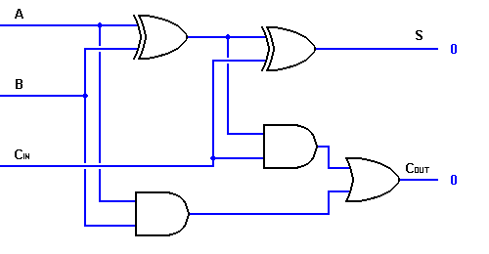
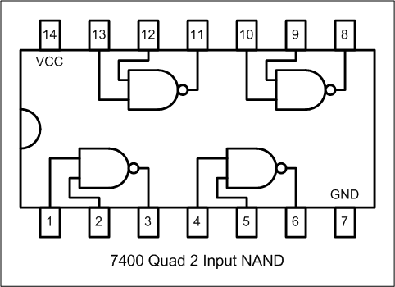
Practice
Implement a full adder (Example 2.13 in textbook) using 2-input NAND gates only

Slide 20
Homework
For #1 and #2, do it individually.
For #3, do it per team.
Submit a report per person.

Slide 21
Homework
1. Draw a circuit diagram for the below formula using ONLY NOR
gates and NOT gates. You can draw it by hand or using any of a
computer program.
- Y = A(B+CD)
2. Y = AB + ABC + A’B + AB’C
Make a truth table
Minimize # of operators
Draw a circuit diagram

Slide 22
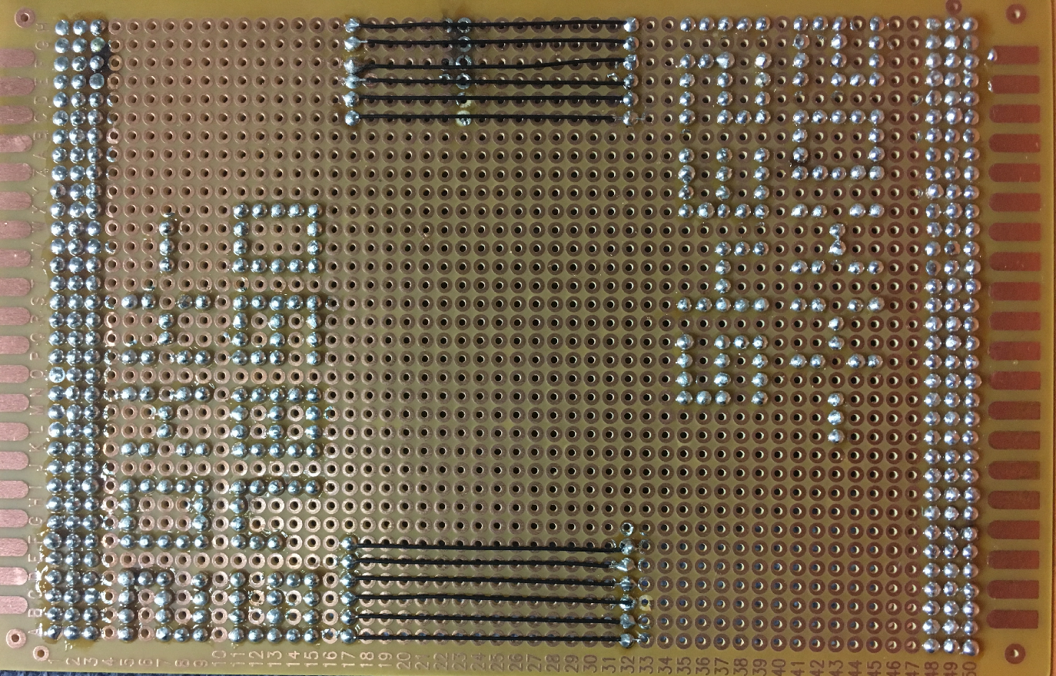
Homework (Cont’d)
3. [TEAM]
Practice soldering and wiring as the figure below. (Soldering 6
lines and 2 student IDs, and 12 wires for each team)

Slide 23
Homework
Write a report
Either in Korean or in English
Must include the result and discussion of the practice
# of pages doesn’t matter
Documents should be submitted as PDF file.
All the files should be compressed to ZIP format
(if there are several files)
Due : March, 27st (Before class begin at 7:00pm)

